Slide 1
Paragraphing
SJC South/Laurence Finn
October 19, 2019

Slide 2
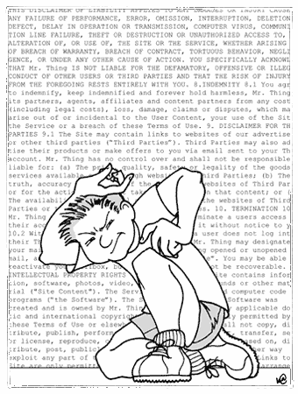
Paragraphing
Why are paragraphs important?
Helps organize your writing, guides the reader
Allows readers to search and skim through your work
Avoid the dreaded “Wall of Text!”

Slide 3
Topic Sentences
A topic sentence states the main idea of a paragraph in a clear, specific way.
It’s like a “miniature thesis statement” that defines the scope of a single paragraph.
However, unlike a thesis statement, a topic sentence is usually located at the beginning of a paragraph (as either the first or second sentence).
These can help a reader skim your document easily.
This is especially important in the business world, where managers have limited time

Slide 4
Key Concepts
Three key concepts for Paragraphs:
Unity
Sensible Lengths
Cohesion

Slide 5
Paragraph Unity
A paragraph is unified when every supporting sentence matches the topic (first) sentence.
For example, a paragraph starting with “Solar power is extremely efficient if used properly” should be followed by supporting sentences that match the topic of solar power efficiency/cost.
“Many laws have been passed to help proliferate solar power in the United States” would not fit the above topic.

Slide 6
Paragraph Length
Paragraph length is also an important consideration:
Paragraphs that are too short may not include enough information
Paragraphs that are too long will ultimately bore the reader. They may have too broad a topic sentence, or too much obvious information.
Don’t necessarily delete long paragraphs; try splitting them first
Varying length throughout your essay can help keep your writing fresh for the reader.

Slide 7
Paragraph Cohesion
A paragraph is cohesive when each sentence is connected by a logical order of thought and by strong transitions
“However. . .” “For example. . .” “Despite this. . .”
Repetition, used sparingly, can help paragraph cohesion.
A paragraph about heart conditions might use the word “cardiac” two or three times to link closely related ideas

Slide 8
Paragraph Cohesion, continued
Organizing from “general to specific” or “specific to general” can help cohesion
Your paragraph might begin with “Solar arrays are an efficient source of energy,” lead into a sentence or two about costs of installation and usage, and finish with detailed statistics comparing to other types of energy production
Easy concepts, then more complicated
Gives readers a chance to skip and move on

Slide 9
Sources/Backup

Slide 10
Sources
Image on Slide 2: https://tvtropes.org/pmwiki/pmwiki.php/Main/WallofText
Lunsford, Andrea. Easywriter. Boston, Bedford/St. Martin’s, 2019.

